Slide 1
Symbolic Execution (II)

Slide 2
On SLAM
https://www.microsoft.com/en-us/research/project/slam/
2001 project
Static Driver Verifier in the Windows Driver Development Kit that uses the SLAM verification engine.
“Things like even software verification, this has been the Holy Grail of computer science for many decades but now in some very key areas, for example, driver verification we’re building tools that can do actual proof about the software and how it works in order to guarantee the reliability.” Bill Gates, April 18, 2002. Keynote address at WinHec 2002

Slide 3
“Things like even software verification, this has been the Holy Grail of computer science for many decades but now in some very key areas, for example, driver verification we’re building tools that can do actual proof about the software and how it works in order to guarantee the reliability.” Bill Gates, April 18, 2002. Keynote address at WinHec 2002

Slide 4
reverse and binary analysis by angr
angr 第一個範例, 惡意軟體分析: >>> import angr >>> proj = angr.Project('./fauxware') >>> cfg = proj.analyses.CFG() >>> dict(proj.kb.functions) .... >>> pg = proj.factory.path_group().explore(find=0x80485c9) >>> pg.found[0].state.posix.dumps(0) '\x00\x00\x00\x00\x00\x00\x00\x00\x00SOSNEAKY\x00'

Slide 5
Determine what Inputs execute a designated part of a program
Symbolic Execution:
Generalized Symbolic Execution
Dynamic Test Generation (Concolic)

Slide 6
暖身
install klee docker and exercise
http://klee.github.io/docker/
docker -it klee/klee
problem 0x06
install angr docker and exercise
http://angr.io/install.html
docker -it angr/angr
problem 0x07

Slide 7
Symbolic Execution
Symbolic State
variables ⇒ symbolic expressions
symbolic path constraint PC
Every conditional statement
if (e) S1 else S2
PC ← PC ∧ 𝞼(e) (“than” branch)
PC’ ← PC ∧ ¬𝞼(e) (“else” branch)
𝞼(e) denotes the symbolic predicate by evaluating e in symbolic state 𝞼
If PC or PC’ becomes un-satisfiable, symbolic execution terminates
Whenever symbolic exectuion along a path terminates, ccurent PC is solved and the solution is the test inputs
If the program executes on the test inputs, it will take the same path as the symboli execution and terminate

Slide 8
Generalized Symbolic Execution
classical symbolic execution with multi-threading and inputs with recursive data structures
model checker to handle multi-threading and non-determinism
non-deterministicaly initialize fields when first access to uninitialized fields
Once field initialized, execution proceeds acording to the concrete execution semantics

Slide 9
Dynamic Test Generation
Improve the classical symbolic execution
making distinction between the concrete and the symbolic state of a program
Code run unmodified, only statements depending on the symbolic input treated differently
adding constraints to the current path condition
Exponential number of paths
heruistics to guide pah exploration
interleaving symbolic execution with random testing
caching function summaries for laster use by higher-level functions
eliminating redundant paths for values read and written by the program

Slide 10
Important Systems
DART
Godefroid and Sen, PLDI 2005
CUTE: concolic, unit level
SAGE/Catchconv
Generational search
Production software since 2007
first whole application
EXE/EGT
system code
KLEE: with environment model
Mayhem
Mergepoint

Slide 11
DART (PLDI 2005)
DART: directed automated random testing, P Godefroid, N Klarlund, K Sen, PLDI2005
dynamic test generation with random testing and model checking techniques
systematically executing all feaible paths of a program
Start with given or random concrete inputs
Gather symbolic constraints on inputs at conditional statements
First Dynamic Test Generation with Symbolic Execution

Slide 12
Example (C code)
int double(int x) {
return 2 * x;
}
void test_me(int x, int y) {
int z = double(x);
if (z==y) {
if (y == x+10)
abort(); /* error */
}
}
(1) Interface extraction:
parameters of toplevel function
external variables
return values of external functions
(2) Generation of test driver for random testing:
main(){
int tmp1 = randomInt();
int tmp2 = randomInt();
test_me(tmp1,tmp2);
}
Closed (self-executable) program that can be run
Problem: probability of reaching abort() is extremely low!

Slide 13
DART Step (3): Directed Search
main(){
int t1 = randomInt();
int t2 = randomInt();
test_me(t1,t2);
}
int double(int x) {return 2 * x; }
void test_me(int x, int y) {
int z = double(x);
if (z==y) {
if (y == x+10)
abort(); /* error */
}
}
Concrete Execution
Symbolic Execution
Path Constraint
create symbolic
variables x, y
x = 36, y = 99

Slide 14
DART Step (3): Directed Search
main(){
int t1 = randomInt();
int t2 = randomInt();
test_me(t1,t2);
}
int double(int x) {return 2 * x; }
void test_me(int x, int y) {
int z = double(x);
if (z==y) {
if (y == x+10)
abort(); /* error */
}
}
Concrete Execution
Symbolic Execution
Path Constraint
create symbolic
variables x, y
x = 36, y = 99,
z = 72
z = 2 * x

Slide 15
DART Step (3): Directed Search
main(){
int t1 = randomInt();
int t2 = randomInt();
test_me(t1,t2);
}
int double(int x) {return 2 * x; }
void test_me(int x, int y) {
int z = double(x);
if (z==y) {
if (y == x+10)
abort(); /* error */
}
}
Concrete Execution
Symbolic Execution
Path Constraint
Solve: 2 * x == y
Solution: x = 1, y = 2
create symbolic
variables x, y
2 * x != y
x = 36, y = 99,
z = 72
z = 2 * x

Slide 16
DART Step (3): Directed Search
main(){
int t1 = randomInt();
int t2 = randomInt();
test_me(t1,t2);
}
int double(int x) {return 2 * x; }
void test_me(int x, int y) {
int z = double(x);
if (z==y) {
if (y == x+10)
abort(); /* error */
}
}
Concrete Execution
Symbolic Execution
Path Constraint
create symbolic
variables x, y
x = 1, y = 2

Slide 17
DART Step (3): Directed Search
main(){
int t1 = randomInt();
int t2 = randomInt();
test_me(t1,t2);
}
int double(int x) {return 2 * x; }
void test_me(int x, int y) {
int z = double(x);
if (z==y) {
if (y == x+10)
abort(); /* error */
}
}
Concrete Execution
Symbolic Execution
Path Constraint
create symbolic
variables x, y
z = 2 * x
x = 1, y = 2, z = 2

Slide 18
DART Step (3): Directed Search
main(){
int t1 = randomInt();
int t2 = randomInt();
test_me(t1,t2);
}
int double(int x) {return 2 * x; }
void test_me(int x, int y) {
int z = double(x);
if (z==y) {
if (y == x+10)
abort(); /* error */
}
}
Concrete Execution
Symbolic Execution
Path Constraint
Solve: (2 * x == y) and (y == x +10)
Solution: x = 10, y = 20
create symbolic
variables x, y
2 * x == y
y != x + 10
x = 1, y = 2, z = 2
z = 2 * x

Slide 19
DART Step (3): Directed Search
main(){
int t1 = randomInt();
int t2 = randomInt();
test_me(t1,t2);
}
int double(int x) {return 2 * x; }
void test_me(int x, int y) {
int z = double(x);
if (z==y) {
if (y != x+10)
abort(); /* error */
}
}
Concrete Execution
Symbolic Execution
Path Constraint
create symbolic
variables x, y
x = 10, y = 20

Slide 20
DART Step (3): Directed Search
main(){
int t1 = randomInt();
int t2 = randomInt();
test_me(t1,t2);
}
int double(int x) {return 2 * x; }
void test_me(int x, int y) {
int z = double(x);
if (z==y) {
if (y == x+10)
abort(); /* error */
}
}
Concrete Execution
Symbolic Execution
Path Constraint
create symbolic
variables x, y
x = 10, y = 20, z = 20
z = 2 * x

Slide 21
DART Step (3): Directed Search
main(){
int t1 = randomInt();
int t2 = randomInt();
test_me(t1,t2);
}
int double(int x) {return 2 * x; }
void test_me(int x, int y) {
int z = double(x);
if (z==y) {
if (y == x+10)
abort(); /* error */
}
}
Concrete Execution
Symbolic Execution
Path Constraint
create symbolic
variables x, y
x = 10, y = 20, z = 20
z = 2 * x
2 * x == y

Slide 22
DART Step (3): Directed Search
main(){
int t1 = randomInt();
int t2 = randomInt();
test_me(t1,t2);
}
int double(int x) {return 2 * x; }
void test_me(int x, int y) {
int z = double(x);
if (z==y) {
if (y == x+10)
abort(); /* error */
}
}
Concrete Execution
Symbolic Execution
Path Constraint
Program Error
create symbolic
variables x, y
2 * x == y
z = 2 * x
y == x +10
x = 10, y = 20, z = 20

Slide 23
Novelty: Simultaneous Concrete & Symbolic Executions
void foo(int x,int y){
int z = x*x*x; /* could be z = h(x) */
if (z == y) {
abort(); /* error */
}
}
Assume we can reason about linear constraints only
Initially x = 3 and y = 7 (randomly generated)
Concrete z = 27, but symbolic z = x*x*x
Cannot handle symbolic value of z!
Stuck?

Slide 24
Novelty: Simultaneous Concrete & Symbolic Executions
Assume we can reason about linear constraints only
Initially x = 3 and y = 7 (randomly generated)
Concrete z = 27, but symbolic z = x*x*x
Cannot handle symbolic value of z!
Stuck?
NO! Use concrete value z = 27 and proceed…
Take else branch with constraint 27 != y
Solve 27 = y to take then branch
Execute next run with x = 3 and y = 27
DART finds the error!
void foo(int x,int y){
int z = x*x*x; /* could be z = h(x) */
if (z == y) {
abort(); /* error */
}
}
Replace symbolic expression by concrete value when symbolic expression becomes unmanageable (e.g. non-linear)
NOTE: whenever symbolic execution is stuck, static analysis becomes imprecise!

Slide 25
CUTE
CUTE (Concolic Unit Testing Engine)
Sen, Koushik, Darko Marinov, and Gul Agha. "CUTE: a concolic unit testing engine for C." ACM SIGSOFT Software Engineering Notes. Vol. 30. No. 5. ACM, 2005.
Extends DART to handle multi-threaded programs
dynamic data structures using pointer operations
pointer analysis by representing and solving pointer constraints approximately
systematically generate both test inputs and thread schedules
Test java.util library and JDK 1.4 (by jCUTE)

Slide 26
Execution Paths of a Program
Can be seen as a binary tree with possibly infinite depth
Computation tree
Each node represents the execution of a “if then else” statement
Each edge represents the execution of a sequence of non-conditional statements
Each path in the tree represents an equivalence class of inputs
0
1
1
0
1
0
1
0
1
1
0
1

Slide 27
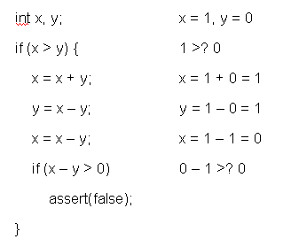
Concrete Execution Path (example)

Slide 28
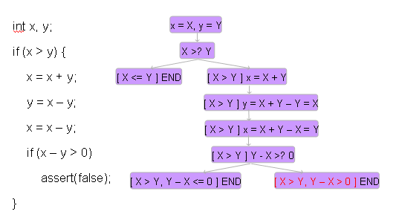
Symbolic Execution Path (example)

Slide 29
Concolic Execution
Automated Scalable Unit Testing of real-world C Programs
Generate test inputs
Execute unit under test on generated test inputs
so that all reachable statements are executed
Any assertion violation gets caught
Concolic Approach:
Explore all execution paths of an Unit for all possible inputs
Exploring all execution paths ensure that all reachable statements are executed

Slide 30
Concolic Execution
Combine concrete and symbolic execution for unit testing
Concrete + Symbolic = Concolic
In a nutshell
Use concrete execution over a concrete input to guide symbolic execution
Concrete execution helps Symbolic execution to simplify complex and unmanageable symbolic expressions
by replacing symbolic values by concrete values
Achieves Scalability
Higher branch coverage than random testing
No false positives or scalability issue like in symbolic execution based testing

Slide 31
Concolic Execution Process
CUTE generates concrete inputs one by one.
The program is executed on that input simultaneously (both concretely & symbolically)
The symb. ex. follows the path taken by the concrete ex. maintains a symb. state, generates path constraints.
The info. collected by the concrete ex. guided symb. ex. is then used to generate inputs for the next ex.
This process continues until all different feasible paths are executed once.

Slide 32
Example
typedef struct cell {
int v;
struct cell *next;
} cell;
int f(int v) {
return 2*v + 1;
}
int testme(cell *p, int x) {
if (x > 0)
if (p != NULL)
if (f(x) == p->v)
if (p->next == p)
abort();
return 0;
}
Random Test Driver:
random memory graph reachable from p
random value for x
Probability of reaching abort( ) is extremely low

Slide 33
CUTE Approach
Concrete Execution
Symbolic Execution
typedef struct cell {
int v;
struct cell *next;
} cell;
int f(int v) {
return 2*v + 1;
}
int testme(cell *p, int x) {
if (x > 0)
if (p != NULL)
if (f(x) == p->v)
if (p->next == p)
abort();
return 0;
}
concrete state
symbolic state
constraints
p , x=236 NULL
p=p₀, x=x₀

Slide 34
CUTE Approach
Concrete Execution
Symbolic Execution
typedef struct cell {
int v;
struct cell *next;
} cell;
int f(int v) {
return 2*v + 1;
}
int testme(cell *p, int x) {
if (x > 0)
if (p != NULL)
if (f(x) == p->v)
if (p->next == p)
abort();
return 0;
}
concrete state
symbolic state
constraints
p , x=236 NULL
p=p₀, x=x₀

Slide 35
CUTE Approach
Concrete Execution
Symbolic Execution
typedef struct cell {
int v;
struct cell *next;
} cell;
int f(int v) {
return 2*v + 1;
}
int testme(cell *p, int x) {
if (x > 0)
if (p != NULL)
if (f(x) == p->v)
if (p->next == p)
abort();
return 0;
}
concrete state
symbolic state
constraints
p , x=236 NULL
p=p₀, x=x₀
x₀>0

Slide 36
CUTE Approach
Concrete Execution
Symbolic Execution
concrete state
symbolic state
constraints
typedef struct cell {
int v;
struct cell *next;
} cell;
int f(int v) {
return 2*v + 1;
}
int testme(cell *p, int x) {
if (x > 0)
if (p != NULL)
if (f(x) == p->v)
if (p->next == p)
abort();
return 0;
}
x₀>0
!(p₀!=NULL)
p , x=236 NULL
p=p₀, x=x₀

Slide 37
CUTE Approach
Concrete Execution
Symbolic Execution
typedef struct cell {
int v;
struct cell *next;
} cell;
int f(int v) {
return 2*v + 1;
}
int testme(cell *p, int x) {
if (x > 0)
if (p != NULL)
if (f(x) == p->v)
if (p->next == p)
abort();
return 0;
}
concrete state
symbolic state
constraints
solve: x₀>0 and p₀≠NULL
x₀>0
p₀=NULL
p , x=236 NULL
p=p₀, x=x₀

Slide 38
CUTE Approach
Concrete Execution
Symbolic Execution
concrete state
symbolic state
constraints
typedef struct cell {
int v;
struct cell *next;
} cell;
int f(int v) {
return 2*v + 1;
}
int testme(cell *p, int x) {
if (x > 0)
if (p != NULL)
if (f(x) == p->v)
if (p->next == p)
abort();
return 0;
}
solve: x₀>0 and p₀≠NULL
x₀=236, p₀
NULL
634
x₀>0
p₀=NULL
p , x=236 NULL
p=p₀, x=x₀

Slide 39
DART Step (3): Directed Search
main(){
int t1 = randomInt();
int t2 = randomInt();
test_me(t1,t2);
}
int double(int x) {return 2 * x; }
void test_me(int x, int y) {
int z = double(x);
if (z==y) {
if (y == x+10)
abort(); /* error */
}
}
Concrete Execution
Symbolic Execution
Path Constraint
create symbolic
variables x, y
x = 1, y = 2, z = 2
z = 2 * x
2 * x == y

Slide 40
CUTE Approach
Concrete Execution
Symbolic Execution
typedef struct cell {
int v;
struct cell *next;
} cell;
int f(int v) {
return 2*v + 1;
}
int testme(cell *p, int x) {
if (x > 0)
if (p != NULL)
if (f(x) == p->v)
if (p->next == p)
abort();
return 0;
}
concrete state
symbolic state
constraints
p , x=236
NULL
p=p₀, x=x₀, p->v =v₀, p->next=n₀
634

Slide 41
CUTE Approach
Concrete Execution
Symbolic Execution
typedef struct cell {
int v;
struct cell *next;
} cell;
int f(int v) {
return 2*v + 1;
}
int testme(cell *p, int x) {
if (x > 0)
if (p != NULL)
if (f(x) == p->v)
if (p->next == p)
abort();
return 0;
}
concrete state
symbolic state
constraints
x₀>0
p , x=236
NULL
p=p₀, x=x₀, p->v =v₀, p->next=n₀
634

Slide 42
CUTE Approach
Concrete Execution
Symbolic Execution
typedef struct cell {
int v;
struct cell *next;
} cell;
int f(int v) {
return 2*v + 1;
}
int testme(cell *p, int x) {
if (x > 0)
if (p != NULL)
if (f(x) == p->v)
if (p->next == p)
abort();
return 0;
}
concrete state
symbolic state
constraints
x₀>0
p₀≠NULL
p , x=236
NULL
p=p₀, x=x₀, p->v =v₀, p->next=n₀
634

Slide 43
CUTE Approach
Concrete Execution
Symbolic Execution
typedef struct cell {
int v;
struct cell *next;
} cell;
int f(int v) {
return 2*v + 1;
}
int testme(cell *p, int x) {
if (x > 0)
if (p != NULL)
if (f(x) == p->v)
if (p->next == p)
abort();
return 0;
}
concrete state
symbolic state
constraints
x₀>0
p₀≠NULL
2x₀+1≠v₀
p , x=236
NULL
p=p₀, x=x₀, p->v =v₀, p->next=n₀
634

Slide 44
CUTE Approach
Concrete Execution
Symbolic Execution
typedef struct cell {
int v;
struct cell *next;
} cell;
int f(int v) {
return 2*v + 1;
}
int testme(cell *p, int x) {
if (x > 0)
if (p != NULL)
if (f(x) == p->v)
if (p->next == p)
abort();
return 0;
}
concrete state
symbolic state
constraints
x₀>0
p₀≠NULL
2x₀+1≠v₀
p , x=236
NULL
p=p₀, x=x₀, p->v =v₀, p->next=n₀
634

Slide 45
CUTE Approach
Symbolic Execution
Concrete Execution
concrete state
symbolic state
constraints
typedef struct cell {
int v;
struct cell *next;
} cell;
int f(int v) {
return 2*v + 1;
}
int testme(cell *p, int x) {
if (x > 0)
if (p != NULL)
if (f(x) == p->v)
if (p->next == p)
abort();
return 0;
}
solve: x₀>0 and p₀≠NULL and 2x₀+1=v₀
x₀>0
p₀≠NULL
2x₀+1≠v₀
p , x=236
NULL
p=p₀, x=x₀, p->v =v₀, p->next=n₀
634

Slide 46
CUTE Approach
Concrete Execution
Symbolic Execution
concrete state
symbolic state
constraints
typedef struct cell {
int v;
struct cell *next;
} cell;
int f(int v) {
return 2*v + 1;
}
int testme(cell *p, int x) {
if (x > 0)
if (p != NULL)
if (f(x) == p->v)
if (p->next == p)
abort();
return 0;
}
solve: x₀>0 and p₀≠NULL and 2x₀+1=v₀
x₀=1, p₀
NULL
3
x₀>0
p₀≠NULL
2x₀+1≠v₀
p , x=236
NULL
p=p₀, x=x₀, p->v =v₀, p->next=n₀
634

Slide 47
CUTE Approach
Concrete Execution
Symbolic Execution
typedef struct cell {
int v;
struct cell *next;
} cell;
int f(int v) {
return 2*v + 1;
}
int testme(cell *p, int x) {
if (x > 0)
if (p != NULL)
if (f(x) == p->v)
if (p->next == p)
abort();
return 0;
}
concrete state
symbolic state
constraints
p , x=1
NULL
p=p₀, x=x₀, p->v =v₀, p->next=n₀
3

Slide 48
CUTE Approach
Concrete Execution
Symbolic Execution
typedef struct cell {
int v;
struct cell *next;
} cell;
int f(int v) {
return 2*v + 1;
}
int testme(cell *p, int x) {
if (x > 0)
if (p != NULL)
if (f(x) == p->v)
if (p->next == p)
abort();
return 0;
}
concrete state
symbolic state
constraints
x₀>0
p , x=1
NULL
p=p₀, x=x₀, p->v =v₀, p->next=n₀
3

Slide 49
CUTE Approach
Concrete Execution
Symbolic Execution
typedef struct cell {
int v;
struct cell *next;
} cell;
int f(int v) {
return 2*v + 1;
}
int testme(cell *p, int x) {
if (x > 0)
if (p != NULL)
if (f(x) == p->v)
if (p->next == p)
abort();
return 0;
}
concrete state
symbolic state
constraints
x₀>0
p , x=1
NULL
p=p₀, x=x₀, p->v =v₀, p->next=n₀
p₀≠NULL
3

Slide 50
CUTE Approach
Concrete Execution
Symbolic Execution
typedef struct cell {
int v;
struct cell *next;
} cell;
int f(int v) {
return 2*v + 1;
}
int testme(cell *p, int x) {
if (x > 0)
if (p != NULL)
if (f(x) == p->v)
if (p->next == p)
abort();
return 0;
}
concrete state
symbolic state
constraints
x₀>0
p₀≠NULL
p , x=1
NULL
p=p₀, x=x₀, p->v =v₀, p->next=n₀
2x₀+1=v₀
3

Slide 51
CUTE Approach
Concrete Execution
Symbolic Execution
typedef struct cell {
int v;
struct cell *next;
} cell;
int f(int v) {
return 2*v + 1;
}
int testme(cell *p, int x) {
if (x > 0)
if (p != NULL)
if (f(x) == p->v)
if (p->next == p)
abort();
return 0;
}
concrete state
symbolic state
constraints
x₀>0
p₀≠NULL
p , x=1
2x₀+1=v₀
NULL
p=p₀, x=x₀, p->v =v₀, p->next=n₀
n₀≠p₀
3

Slide 52
CUTE Approach
Concrete Execution
Symbolic Execution
typedef struct cell {
int v;
struct cell *next;
} cell;
int f(int v) {
return 2*v + 1;
}
int testme(cell *p, int x) {
if (x > 0)
if (p != NULL)
if (f(x) == p->v)
if (p->next == p)
abort();
return 0;
}
concrete state
symbolic state
constraints
x₀>0
p₀≠NULL
2x₀+1=v₀
n₀≠p₀
p=p₀, x=x₀, p->v =v₀, p->next=n₀
p , x=1
NULL
3

Slide 53
CUTE Approach
Concrete Execution
Symbolic Execution
concrete state
symbolic state
constraints
typedef struct cell {
int v;
struct cell *next;
} cell;
int f(int v) {
return 2*v + 1;
}
int testme(cell *p, int x) {
if (x > 0)
if (p != NULL)
if (f(x) == p->v)
if (p->next == p)
abort();
return 0;
}
solve: x₀>0 and p₀≠NULL and 2x₀+1=v₀ and n₀=p₀
.
x₀>0
p₀≠NULL
2x₀+1=v₀
n₀≠p₀
p=p₀, x=x₀, p->v =v₀, p->next=n₀
p , x=1
NULL
3

Slide 54
CUTE Approach
Concrete Execution
Symbolic Execution
concrete state
symbolic state
typedef struct cell {
int v;
struct cell *next;
} cell;
int f(int v) {
return 2*v + 1;
}
int testme(cell *p, int x) {
if (x > 0)
if (p != NULL)
if (f(x) == p->v)
if (p->next == p)
abort();
return 0;
}
constraints
solve: x₀>0 and p₀≠NULL and 2x₀+1=v₀ and n₀=p₀
x₀=1, p₀
x₀>0
3
p₀≠NULL
2x₀+1=v₀
n₀≠p₀
p=p₀, x=x₀, p->v =v₀, p->next=n₀
p , x=1
NULL
3

Slide 55
CUTE Approach
Concrete Execution
Symbolic Execution
typedef struct cell {
int v;
struct cell *next;
} cell;
int f(int v) {
return 2*v + 1;
}
int testme(cell *p, int x) {
if (x > 0)
if (p != NULL)
if (f(x) == p->v)
if (p->next == p)
abort();
return 0;
}
concrete state
symbolic state
constraints
p=p₀, x=x₀, p->v =v₀, p->next=n₀
p , x=1
3

Slide 56
CUTE Approach
Concrete Execution
Symbolic Execution
typedef struct cell {
int v;
struct cell *next;
} cell;
int f(int v) {
return 2*v + 1;
}
int testme(cell *p, int x) {
if (x > 0)
if (p != NULL)
if (f(x) == p->v)
if (p->next == p)
abort();
return 0;
}
concrete state
symbolic state
constraints
x₀>0
p , x=1
p=p₀, x=x₀, p->v =v₀, p->next=n₀
3

Slide 57
CUTE Approach
Concrete Execution
Symbolic Execution
typedef struct cell {
int v;
struct cell *next;
} cell;
int f(int v) {
return 2*v + 1;
}
int testme(cell *p, int x) {
if (x > 0)
if (p != NULL)
if (f(x) == p->v)
if (p->next == p)
abort();
return 0;
}
concrete state
symbolic state
constraints
x₀>0
p₀≠NULL
p , x=1
p=p₀, x=x₀, p->v =v₀, p->next=n₀
3

Slide 58
CUTE Approach
Concrete Execution
Symbolic Execution
typedef struct cell {
int v;
struct cell *next;
} cell;
int f(int v) {
return 2*v + 1;
}
int testme(cell *p, int x) {
if (x > 0)
if (p != NULL)
if (f(x) == p->v)
if (p->next == p)
abort();
return 0;
}
concrete state
symbolic state
constraints
x₀>0
p₀≠NULL
p , x=1
p=p₀, x=x₀, p->v =v₀, p->next=n₀
2x₀+1=v₀
3

Slide 59

CUTE Approach
Concrete Execution
Symbolic Execution
typedef struct cell {
int v;
struct cell *next;
} cell;
int f(int v) {
return 2*v + 1;
}
int testme(cell *p, int x) {
if (x > 0)
if (p != NULL)
if (f(x) == p->v)
if (p->next == p)
abort();
return 0;
}
concrete state
symbolic state
constraints
Program Error
x₀>0
p₀≠NULL
2x₀+1=v₀
n₀=p₀
p , x=1
p=p₀, x=x₀, p->v =v₀, p->next=n₀
3

Slide 60
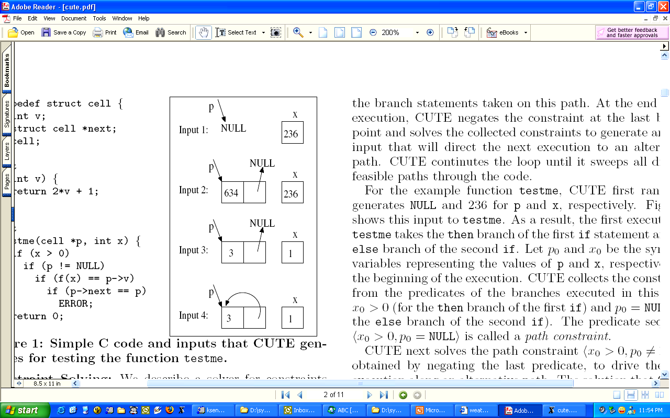
Pointer Inputs: Input Graph
typedef struct cell {
int v;
struct cell *next;
} cell;
int f(int v) {
return 2*v + 1;
}
int testme(cell *p, int x) {
if (x > 0)
if (p != NULL)
if (f(x) == p->v)
if (p->next == p)
abort();
return 0;
}

Slide 61
CUTE in a Nutshell
Generate concrete inputs one by one

Slide 62
CUTE in a Nutshell
Generate concrete inputs one by one
On each input execute program both concretely and symbolically

Slide 63
CUTE in a Nutshell
Generate concrete inputs one by one
On each input execute program both concretely and symbolically
Both cooperate with each other

Slide 64
CUTE in a Nutshell
Generate concrete inputs one by one
On each input execute program both concretely and symbolically
Both cooperate with each other
concrete execution guides the symbolic execution

Slide 65
CUTE in a Nutshell
Generate concrete inputs one by one
On each input execute program both concretely and symbolically
Both cooperate with each other
concrete execution guides the symbolic execution
concrete execution enables symbolic execution to overcome incompleteness of theorem prover
e.x: replace symbolic expressions by concrete values if symbolic expressions become complex

Slide 66
CUTE in a Nutshell
Generate concrete inputs one by one
On each input execute program both concretely and symbolically
Both cooperate with each other
concrete execution guides the symbolic execution
concrete execution enables symbolic execution to overcome incompleteness of theorem prover
e.x: replace symbolic expressions by concrete values if symbolic expressions become complex
symbolic execution helps to generate concrete input for next execution
increases coverage

Slide 67
Simultaneous Symbolic & Concrete Execution
void again_test_me(int x,int y){
z = x*x*x + 3*x*x + 9;
if(z != y){
printf(“Good branch”);
} else {
printf(“Bad branch”);
abort();
}
}
Let initially x = -3 and y = 7 generated by random test-driver

Slide 68
Simultaneous Symbolic & Concrete Execution
void again_test_me(int x,int y){
z = x*x*x + 3*x*x + 9;
if(z != y){
printf(“Good branch”);
} else {
printf(“Bad branch”);
abort();
}
}
Let initially x = -3 and y = 7 generated by random test-driver
concrete z = 9
symbolic z = x*x*x + 3*x*x+9
take then branch with constraint x*x*x+ 3*x*x+9 != y

Slide 69
Simultaneous Symbolic & Concrete Execution
Let initially x = -3 and y = 7 generated by random test-driver
concrete z = 9
symbolic z = x*x*x + 3*x*x+9
take then branch with constraint x*x*x+ 3*x*x+9 != y
solve x*x*x+ 3*x*x+9 = y to take else branch
Don’t know how to solve !!
Stuck ?
void again_test_me(int x,int y){
z = x*x*x + 3*x*x + 9;
if(z != y){
printf(“Good branch”);
} else {
printf(“Bad branch”);
abort();
}
}

Slide 70
Simultaneous Symbolic & Concrete Execution
Let initially x = -3 and y = 7 generated by random test-driver
concrete z = 9
symbolic z = x*x*x + 3*x*x+9
take then branch with constraint x*x*x+ 3*x*x+9 != y
solve x*x*x+ 3*x*x+9 = y to take else branch
Don’t know how to solve !!
Stuck ?
NO : CUTE handles this smartly
void again_test_me(int x,int y){
z = x*x*x + 3*x*x + 9;
if(z != y){
printf(“Good branch”);
} else {
printf(“Bad branch”);
abort();
}
}

Slide 71
Simultaneous Symbolic & Concrete Execution
void again_test_me(int x,int y){
z = x*x*x + 3*x*x + 9;
if(z != y){
printf(“Good branch”);
} else {
printf(“Bad branch”);
abort();
}
}
Let initially x = -3 and y = 7 generated by random test-driver

Slide 72
Simultaneous Symbolic & Concrete Execution
void again_test_me(int x,int y){
z = x*x*x + 3*x*x + 9;
if(z != y){
printf(“Good branch”);
} else {
printf(“Bad branch”);
abort();
}
}
Let initially x = -3 and y = 7 generated by random test-driver
concrete z = 9
symbolic z = x*x*x + 3*x*x+9
cannot handle symbolic value of z

Slide 73
Simultaneous Symbolic & Concrete Execution
void again_test_me(int x,int y){
z = x*x*x + 3*x*x + 9;
if(z != y){
printf(“Good branch”);
} else {
printf(“Bad branch”);
abort();
}
}
Let initially x = -3 and y = 7 generated by random test-driver
concrete z = 9
symbolic z = x*x*x + 3*x*x+9
cannot handle symbolic value of z
make symbolic z = 9 and proceed

Slide 74
Simultaneous Symbolic & Concrete Execution
void again_test_me(int x,int y){
z = x*x*x + 3*x*x + 9;
if(z != y){
printf(“Good branch”);
} else {
printf(“Bad branch”);
abort();
}
}
Let initially x = -3 and y = 7 generated by random test-driver
concrete z = 9
symbolic z = x*x*x + 3*x*x+9
cannot handle symbolic value of z
make symbolic z = 9 and proceed
take then branch with constraint 9 != y

Slide 75
Simultaneous Symbolic & Concrete Execution
void again_test_me(int x,int y){
z = x*x*x + 3*x*x + 9;
if(z != y){
printf(“Good branch”);
} else {
printf(“Bad branch”);
abort();
}
}
Let initially x = -3 and y = 7 generated by random test-driver
concrete z = 9
symbolic z = x*x*x + 3*x*x+9
cannot handle symbolic value of z
make symbolic z = 9 and proceed
take then branch with constraint 9 != y
solve 9 = y to take else branch
execute next run with x = -3 and y= 9
got error (reaches abort)

Slide 76
Simultaneous Symbolic & Concrete Execution
void again_test_me(int x,int y){
z = x*x*x + 3*x*x + 9;
if(z != y){
printf(“Good branch”);
} else {
printf(“Bad branch”);
abort();
}
}
Let initially x = -3 and y = 7 generated by random test-driver
concrete z = 9
symbolic z = x*x*x + 3*x*x+9
cannot handle symbolic value of z
make symbolic z = 9 and proceed
take then branch with constraint 9 != y
solve 9 = y to take else branch
execute next run with x = -3 and y= 9
got error (reaches abort)
Replace symbolic expression by concrete value when symbolic expression becomes unmanageable (i.e. non-linear)

Slide 77
REFERENCES
CUTE: A Concolic Unit Testing Engine for C, Koushik Sen, Darko Marinov, and Gul Agha.
K. Sen and G. Agha, "CUTE and jCUTE : Concolic Unit Testing and Explicit Path Model-Checking Tools"

Slide 78
SAGE
Whitebox fuzzing from unit testing to whole-application testing
Godefroid, Patrice, Michael Y. Levin, and David Molnar. "SAGE: whitebox fuzzing for security testing." Queue 10.1 (2012): 20.
Catchconv: fuzzing of unix applications
Molnar, David A., and David Wagner. "Catchconv: Symbolic execution and run-time type inference for integer conversion errors." UC Berkeley EECS (2007).
Scale to large file parsers with millions of lines of code and execution traces with billions of machine instructions (Microsoft Excel)

Slide 79
SAGE
SAGE found roughly one third of all the bugs discovered by file fuzzing during Microsoft Windows 7’s development
Since 2008, continually running on an average of 100+ machines “fuzzing” hundreds of applications in a dedicated security testing lab
The largest computational usage ever for any SMT solver

Slide 80
EXE
testing complex software , an emphasis on system code
Yang, J., Sar, C., Twohey, P., Cadar, C., & Engler, D. (2006, May). Automatically generating malicious disks using symbolic execution. In 2006 IEEE Symposium on Security and Privacy (S&P'06) (pp. 15-pp). IEEE.
Cadar, C., Dunbar, D., & Engler, D. R. (2008, December). KLEE: Unassisted and Automatic Generation of High-Coverage Tests for Complex Systems Programs. In OSDI (Vol. 8, pp. 209-224).
Model memory with bit-level accuracy
constraint solver: STP
caching and irrelevant constraint elimination

Slide 81
EXE
Discover deep bugs and security vulnerability of complex code
library code
file systems
packet filters
device drivers
network servers and tools

Slide 82
KLEE
a redesign of EXE, on top of LLVM compiler infrastructure
mixed concrete/symbolic execution
model memory with bit-level accruacy
constraint solving optimization
search heuristics
Store large number of concurrent states by exploiting sharing among states at the object- rather than at the page-level in EXE
Deal environment
file system and network
open-sourced since June 2009

Slide 83
CGC CRS
Mayhem
Shellphish
CRAX

Slide 84

Mayhem

Slide 85
Mayhem
https://blog.forallsecure.com/2016/02/09/unleashing-mayhem/

Slide 86
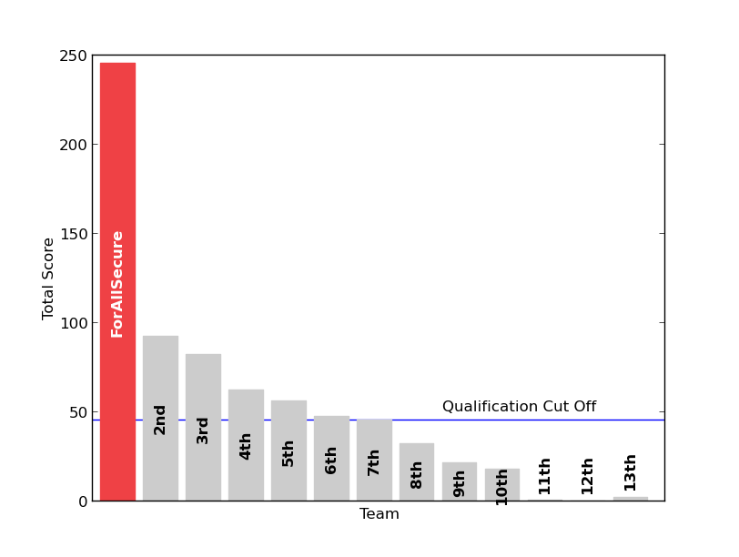
Final scores for teams playing in the DARPA CQE

Slide 87
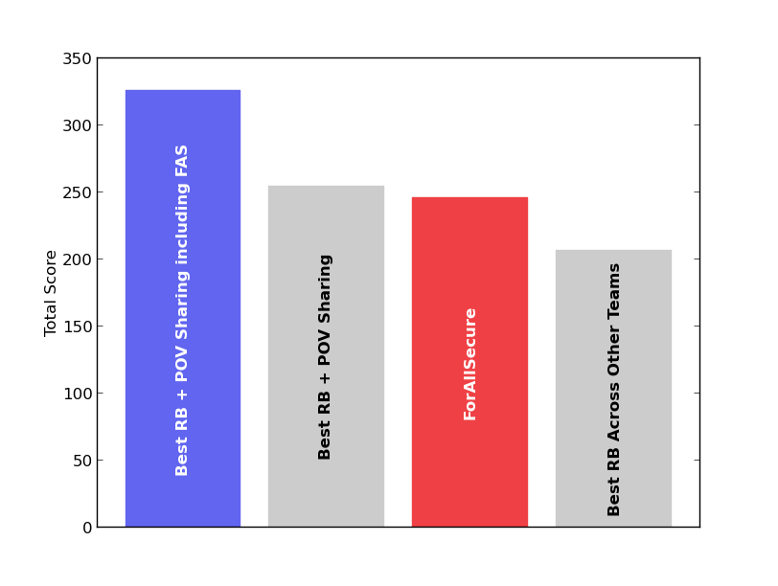
Scores of hypothetical super-teams and ForAllSecure

Slide 88
Scores of hypothetical super-teams and ForAllSecure

Slide 89
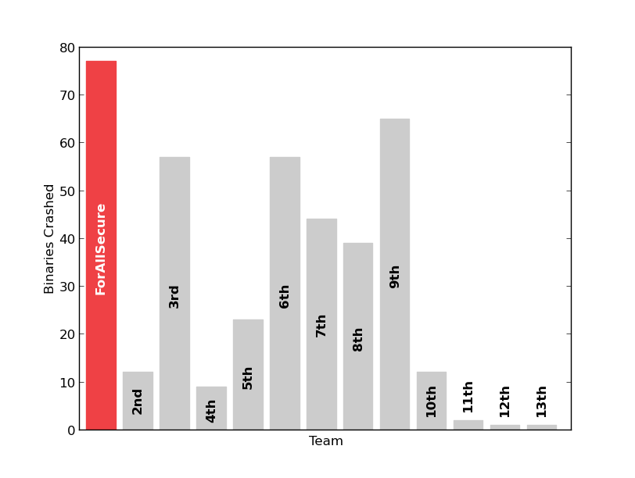
Total number of crashing binaries found by each team during the CQE

Slide 90
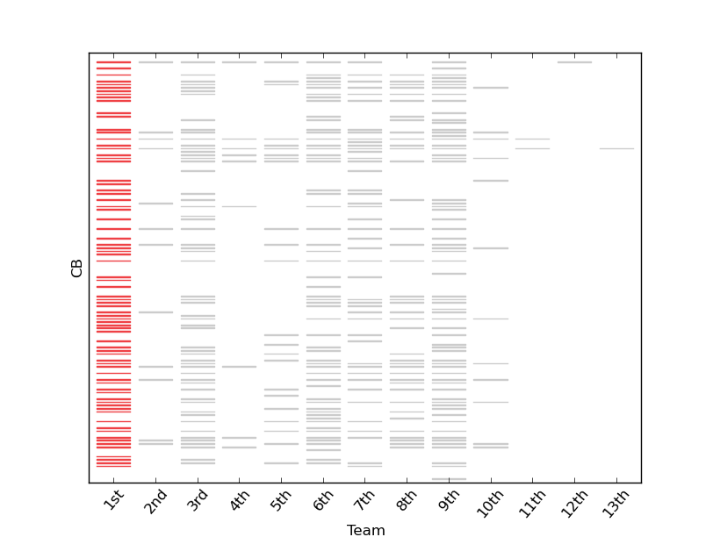
Crashing binaries produced by each team

Slide 91
The bug finder
Mayhem symbolic executor
Murphy directed fuzzer

Slide 92
Mayhem and Murphy
two components communicate through a PostgreSQL database by sharing testcases
find “interesting”, based on the coverage achieve.
using Murphy and Mayhem together, able to boost both:
fuzzer is great at quickly finding shallow bugs, but fails on complex cases;
Mayhem is good at generating deep paths in a program, but is not always fast enough to explore them all.
symbolic executor was able to upload interesting test cases which are picked up by the fuzzer and transformed into crashing inputs.

Slide 93
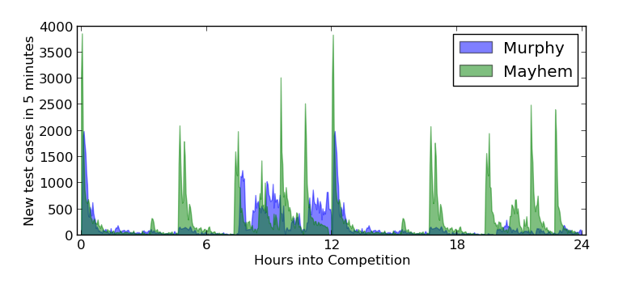
Test case generation by Mayhem and Murphy throughout the entire CQE

Slide 94
Murphy: 65 Crashing CBs
Mayhem: 31 Crashing CBs

Slide 95
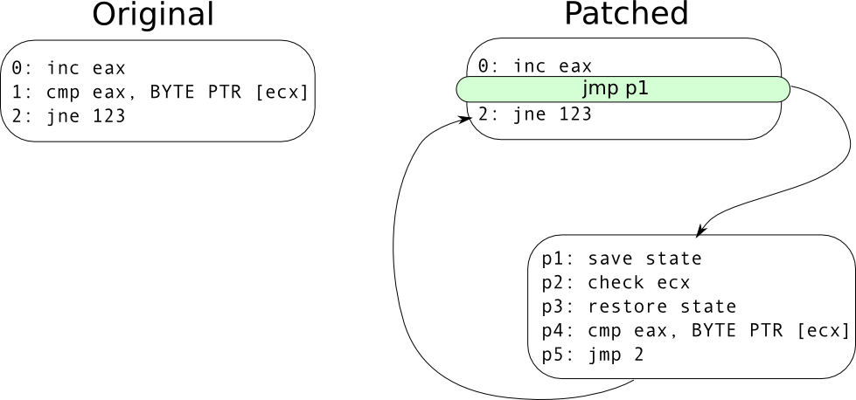
Patch

Slide 96
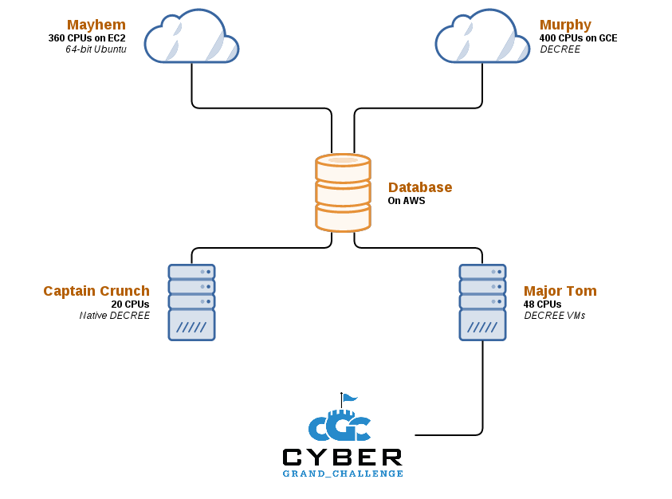
The Infrastructure

Slide 97
The Mechanical Phish
Mechanical Phish was created by Shellphish as our CRS for the DARPA Cyber Grand Challenge.
https://github.com/mechaphish/mecha-docs
components
https://github.com/angr - Core angr components and interesting static analyses
https://github.com/shellphish - hacking tools, generally anything that's useful outside the CGC
https://github.com/mechaphish - CRS bookkeping or utility components

Slide 98
Workers
Worker - the actual glue
Rex - Shellphish's automated exploitation component
Patcherex - Shellphish's automatic patching engine.
Fuzzer - a Python wrapper around AFL, and the fuzzer component of the Shellphish CRS.
Tracer - Component that traces CGC binaries symbolically with concrete inputs (convenience wrapper for concolic tracing).
Driller - The Shellphish CRS "smart fuzzer".
Shellphish-QEMU - A pip wrapper around our ridiculous amounts of qemu ports.
Shellphish-AFL - A pip wrapper to easily distribute AFL.

Slide 99
Rex
crash triaging
crash exploration
exploitation for certain kinds of crashes.
see example explanation from:
https://github.com/shellphish/rex

